Slide 1
SENG 438 Software Testing, Reliability & Quality
Chapter 3: Criteria-Based Test Design Unit Testing
Department of Electrical & Computer Engineering, University of Calgary
B.H. Far （far@ucalgary.ca）
http://people.ucalgary.ca/~far

Slide 2
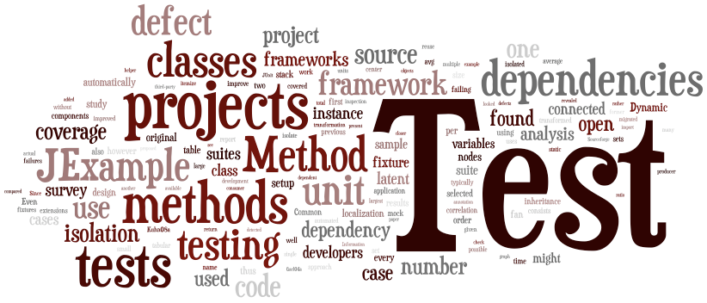
Contents
Introduction to criteria-based test design
Unit testing
Automated test execution
JUnit
Dependencies
Stubbing – mocking

Slide 3
Types of Testing
Functional Testing: testing functional requirements
Functional testing is checking correct functionality of a system
Non-functional Testing: testing non-functional requirement,
e.g. performance, reliability, security
Our focus
Later

Slide 4
What are Non-functions?
Performance testing
Localization/Internationalization testing
Recovery testing
Security testing
Portability testing
Compatibility testing
Usability testing
Scalability testing
Reliability testing
…ilities!

Slide 5
The Testing Dilemma
Using limited resources (time, personnel, budget) efficiently

Slide 6
Criteria Based Testing
What is a criterion anyway?
A testing related concept you build your test cases around it systematically and efficiently
Partitioning
Coverage (i.e. statement, decision, condition, path)
Mutation
Acceptance
etc.
Notes:
What is a “criterion”? Coverage (i.e. statement, decision, condition, path, etc.), mutation, acceptance

Slide 7
Testing Approaches
Exhaustive testing
Pros: guarantee
Cons: infeasible in most real world applications
Random testing (ad-hoc, exploratory)
Pros: cheap
Cons: inefficient in many situations
Partitioning
Pros: effective in theory
Cons: practical solutions?
Done
Already

Slide 8
Exhaustive Testing
Exhaustive testing, i.e., testing a software system using all the possible inputs, is impossible (most of the time)
Example:
A compiler (e.g., javac)
Exhaustive testing = running the (Java) compiler with any possible (Java) program (i.e., source code)

Slide 9
Partitioning Techniques
Non-systematic - human-based
Exploratory
Systematic
Covered already
Next two weeks

Slide 10
Partitioning: Systematic
Partition the set of possible behaviors of the system
Choose representative samples from each partition
Make sure we covered all partitions
How do you identify suitable partitions?
That is what testing is mostly about!!!"
Methods:
black box, white box, ...
path based, state based, risk based, scenario based, …
Criterion

Slide 11
Criteria Based Technique
Black-box
Access to specification is granted
Goal: Increase input domain coverage
Partitions are based on slices of requirements and their expected behavior
White-box
Access to source code is granted
Goal: Increase code coverage
Partitions are based on grouping input domain elements into classes that cover different statements/branches/paths in the source code

Slide 12
Example: Black Box
Specification of Compute Factorial Number:
if the input value n < 0, then an error message must be printed
if 0 <= n < 20, then the exact value of n! must be printed
if 20 <= n < 200, then an approximate value of n! must be printed in floating point format, e.g., using some approximate method of numerical calculus (admissible error is 0.1% of the exact value)
Finally, if n>=200, the input can be rejected by printing an error message
Classes: {n<0}, {0<= n <20}, {20 <= n < 200}, {n >= 200}

Slide 13
Example: White Box
1. if x > y then
2. Max := x;
3. else
4. Max :=x ; // BUG!
Class 1: x>y
Class 2: x<=y
Test suite: {x=3, y=2} cannot detect the fault
Statement coverage = 2/4 (lines 1 and 2)
Test suite: {x=3, y=2} {x=4, y=3} {x=5, y=1} is larger but cannot detect the fault
Statement coverage = 2/4 (lines 1 and 2)
Test suite: {x=3, y=2} {x=2, y=3} can detect the fault
Statement coverage = 4/4 (all lines)

Slide 14
Black vs. White Box Testing
Notes:
Functionalities not implemented cannot be tested by white-box testing.
Unexpected behavior cannot be tested by Black-box testing.

Slide 15
Black vs. White Box Testing

Slide 16
Section 2
Unit Testing

Slide 17
Unit Testing Scenario
Grab the code you want to test (SUT),
e.g. add(x,y)
Write a program that calls SUT and executes it with the setup value of its arguments and spits out the execution result,
e.g., x=2 and y=3, result=5
Check if the result meets the expected result or not
How realistic is this scenario?
What difficulties it may cause?
How to automate this scenario?
Notes:
Difficulty: scalability, manual check of results
Remember even you automate the process you still need to write your test cases. No tool can help you with it.

Slide 18
Unit Testing
Scope: Ensure that each unit (i.e. class, subsystem) has been implemented correctly
Looking for faults in a subsystem in isolation
Generally a “subsystem” means a particular class or object
Method:
For a given class Foo, create another class FooTest to test it, containing various "test case" methods to run
Each method looks for particular results and passes / fails
Often based on white-box testing
Notes:
In object-oriented programming, the smallest unit is a method which may belong to a base/super class, abstract class or derived/child class.
Can be done as black-box when you have the methods/classes but not the code implementing each class/method.

Slide 19
Unit Testing: Characteristics
A unit test must only test one specific unit of functionality (e.g. class or method)
It is fast
10-minute build
It does not access a database or the file system
It does not communicate via a network
It does not require any special setup to the system environment such as modifying a configuration file
It leaves the system and the system environment in the same state that it had prior to the test
Focus on developed components only

Slide 20
Unit Testing: What to Test?
One sample from each equivalent class of input data
Works for both white box and black box tests
Invalid data
Null, missing, empty, ...
Boundaries
Valid Input data set: <0, 1, 2, 3, 4, .... , 10>
Boundary analysis <-1, 0, 1, 9, 10, 11> One sample from each class
Interface to other systems
Acquired
components
Developed
components
OS, System software
Hardware
Notes:
BLB : a value just below the lower bound
LB : the value on the lower boundary
ALB : a value just above the lower boundary
BUB : a value just below the upper bound
UB : the value on the upper bound
AUB : a value just above the upper bound

Slide 21
Unit Testing: When to Test?
Waterfall
Typically written as (or after) the system has been developed
TDD/Agile
Each unit test is written before or during the corresponding code being written
If you find it difficult to write unit tests, it is likely an indication of poor requirements, design or coding practices
Notes:
Unit tests in waterfall are written after (sometimes long after) the implementation of the associated code
The tests typically do not provide good coverage
The tests are written too late to provide one of the major benefits of tests

Slide 22
Section 3
Automated Test Execution
JUnit

Slide 23
Test Automation Framework
A set of assumptions, concepts, and mainly tools, that support test automation
Some unit testing frameworks
.NET
NUnit
Pex
PHP
PHPUnit
JavaScript
JSUnit
Jasmine (not Xunit)
JasUnit
Java
JUnit
TestNG
Notes:
Note: These tools/techniques will help you execute your tests automatically. They will not help with creating your test cases. You still need to write your test cases manually!
xUnit is the collective name for several unit testing frameworks that derive their structure and functionality from Smalltalk's SUnit.
SUnit, designed by Kent Beck in 1998.

Slide 24
JUnit
Java testing framework used to write and run tests
Open source (junit.org)
Helps test execution automation
Good for large scale testing
Repeatable/Automated test procedure
Massive input data possible
Widely used in industry
Can be used as stand alone Java programs (from the command line) or within an IDE such as Eclipse
Notes:
JUnit provides "assert" commands to help us write tests
The idea: Put assertion calls in your test methods to check things you expect to be true. If they aren't, the test will fail.
Was written by Erich Gamma (of Design Patterns fame) and
Kent Beck (creator of XP methodology)

Slide 25
JUnit in a Nutshell
Java code of your tests
Need this to run your tests on SUT
Need this to setup running env for your tests

Slide 26
JUnit: Terminology
Test runner: A test runner is an executable program that runs tests implemented using JUnit framework and reports test results (in command line mode) or update the display (in IDE)
Test fixtures: A test fixture (context) is the set of preconditions or state needed to run a test
Test case: A test case is the most elemental class. All unit tests are inherited from here
Test suites: A test suite is a set of tests that all share the same fixture. The order of the tests shouldn't matter
Notes:
Test Runners work on the highest level of abstraction out of all testing software. All the other testing software takes place within the test runner. As a result, it is necessary to configure the test runner to work with the other testing software which plug into it.
A test fixture is a fixed state of a set of objects used as a baseline for running tests. The purpose of a test fixture is to ensure that there is a well known and fixed environment in which tests are run so that results are repeatable.

Slide 27
JUnit: Terminology
Test drivers: Modules that act as temporary replacement for a calling module and give the same output as that of the actual product
Test execution: The execution of an individual unit test proceeds as follows: annotations @Before @Test @After
--or-- setup(); Body of test; teardown();
Test result formatter: A test runner produces results in one or more output formats, e.g. XML
Assertions: An assertion is a function or macro that verifies the behavior (or the state) of the unit under test, e.g. true, false, null

Slide 28
JUnit: Which Version to Use?
Junit 4.x or 5.x?
The newer the better but we have to learn the differences
Architectural difference
JDK compatibility
Assertion
Annotation
Assumptions
Parameterized test
Some older systems test suites
are still in JUnit 3 so we need
to be familiar with them, too
We will use either of JUnit 4 or 5 in the exercises and Labs

Slide 29
JUnit 4 vs. JUnit 5
JUnit 5 (Sept 2017) requires Java 8 or higher
JUnit 4 requires Java 5 or higher, it uses a lot from Java 5 annotations, generics, and static import features
The JUnit 3.x version can work with JDK 1.2+ and any higher versions
JUnit 5 is backward compatible with JUnit 4 /3 (i.e. JUnit 3 or 4 tests work in JUnit Vintage)
JUnit 5 = JUnit Platform + JUnit Jupiter + JUnit Vintage
https://howtoprogram.xyz/2016/08/10/junit-5-vs-junit-4/
Notes:
Architecture:
JUnit 4. All in one.
JUnit 5. There are 3 separated modules:
JUnit 5 = JUnit Platform + JUnit Jupiter + JUnit Vintage
JUnit Platform
Foundation for launching testing frameworks on the JVM. Defines the TestEngine API for developing a testing framework that runs on the platform.
JUnit Jupiter
Includes new programming model and extension model for writing tests and extensions in JUnit 5 such as new assertions, new annotations, Java 8 Lambda Expressions, etc.
JUnit Vintage
Supports running JUnit 3 and JUnit 4 based tests on the JUnit 5 platform.

Slide 30
JUnit 4 vs. JUnit 5
Defining tests
In the JUnit 4 and 5, test classes are no longer required to extend junit.framework.TestCase class
Test names are no longer need required to follow the testXXX pattern, i.e. do not prefix the test method with “test”
Instead, in JUnit4/5, any public class with a zero-argument public constructor can act as a test class, any methods which are considered as a test method should be annotated with the @Test annotation
JUnit4/5 use one of the assert() methods
JUnit4 runs the test using JUnit4TestAdapter
We will use either of JUnit 4 or 5 in the exercises and Labs

Slide 31
Anatomy of Junit Testing
1. Get the SUT
2. Create test case class(es)
Create tests for each method in the SUT
3. Create test suite class
4. Create test runner class
5. Compile and run

Slide 32
A JUnit Test Case
Annotation
Assertion
Method to be tested
Notes:
There are a few more annotations and assertions in Junit 5.

Slide 33
A JUnit Test Class
A method with @Test is flagged as a JUnit test case
All @Test methods run when JUnit runs your test class
Standard imports
for all JUnit classes
import static org.junit.Assert.*;
import org.junit.*;
import java.util.*;
public class TestJunit1 {
... // some code referring to the SUT
@Test
public void TestMethod1() { // a test case method
... // put assertions here
}
}

Slide 34
A JUnit Test Suite
In JUnit 3, the way of constructing sets of your tests involved writing a suite() method and manually inserting all tests that you want to be present in the suite
In JUnit 4-5, the suite construction is done by two annota tions: @RunWith and @Suite Classes annotations
Optional for running tests in command line
package my.package.tests;
@RunWith(Suite.class)
@Suite.SuiteClasses({
TestJunit1.class,
TestJunit2.class,
...
})
public class JunitTestSuite {}
Notes:
When a class is annotated with @RunWith or extends a class annotated with @RunWith, JUnit will invoke the class it references to run the tests in that class instead of the runner built into JUnit. For example, suites in JUnit 4 are built using RunWith, and a custom runner named Suite:
Now you can run this in a couple different ways:
1. right-click and run in Eclipse as Junit test
2. create a runnable Java Application; Main class='org.junit.runner.JUnitCore' and Args='my.package.tests.AllTests'
run from the command line:
$ java -cp build/classes/:/usr/share/java/junit4.jar:/usr/share/java/hamcrest-core.jar org.junit.runner.JUnitCore my.package.tests.AllTests

Slide 35
A JUnit Test Runner
Create a java class file named TestRunner.java
Compile all the java classes using javac
Finally run the TestRunner
import org.junit.runner.JUnitCore;
import org.junit.runner.Result;
import org.junit.runner.notification.Failure;
public class TestRunner {
public static void main(String[] args) {
Result result = JUnitCore.runClasses(JunitTestSuite.class);
for (Failure failure : result.getFailures()) {
System.out.println(failure.toString());
}
System.out.println(result.wasSuccessful());
}
}

Slide 36
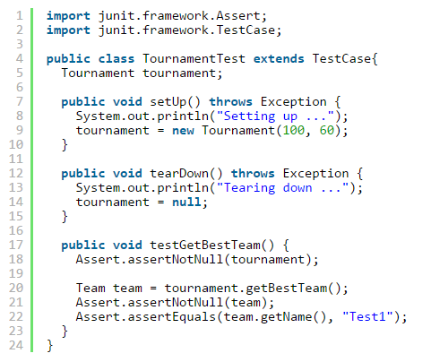
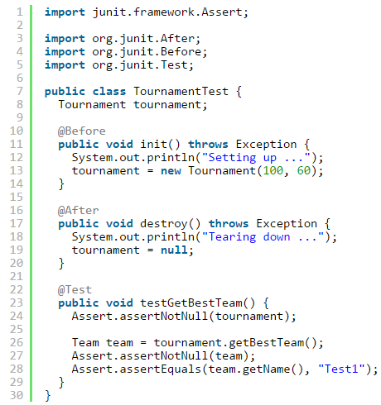
JUnit 3 vs. JUnit 4 / 5
Defining test case:
Extending TestCase is required in JUnit 3
JUnit 4
JUnit 3

Slide 37
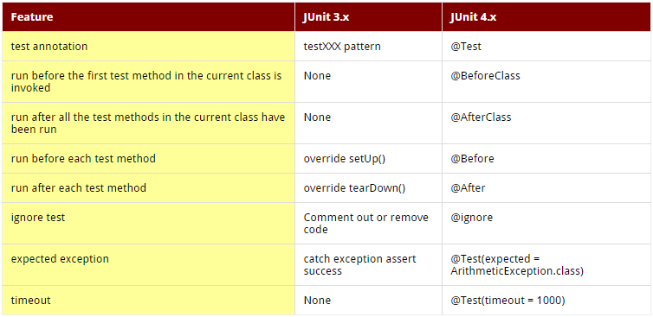
JUnit - Annotations
No annotations in JUnit 3

Slide 38
JUnit - Annotations
Additional annotations in JUnit 5
Features | JUnit 5 | JUnit 4
Declares a test method | @Test | @Test
Denotes that the annotated method will be executed before all test methods in the current class | @BeforeAll | @BeforeClass
Denotes that the annotated method will be executed after all test methods in the current class | @AfterAll | @AfterClass
Denotes that the annotated method will be executed before each test method | @BeforeEach | @Before
Denotes that the annotated method will be executed after each test method | @AfterEach | @After
Disable a test method or a test class | @Disable | @Ignore
Denotes a method is a test factory for dynamic tests in JUnit 5 | @TestFactory | N/A
Denotes that the annotated class is a nested, non-static test class | @Nested | N/A
Declare tags for filtering tests | @Tag | @Category
Register custom extensions in JUnit 5 | @ExtendWith | N/A
Repeated Tests in JUnit 5 | @RepeatedTest | N/A

Slide 39
JUnit - Ignoring a Test
Ignoring a test
In JUnit 3.x comment out the whole test method or rename the method
In JUnit 4.x, use @Ignore
In JUnit 5, use @Disable

Slide 40
JUnit - Timeout
In JUnit 3 Not supported
In JUnit 4, 5 use timeout parameter added to @Test annotation
With timeout parameter, you can specify a value (in milliseconds) that you expect to be the upper limit of the time you spend executing your test
or
@Test(timeout = 1000)
@Rule
public Timeout globalTimeout = Timeout.seconds(2);
Notes:
Use @Rule annotation. This is helpful when we want all our test cases to be passed within a specific time.
For example, we want our each test case to be executed in 2 seconds.
@Rule can be used in Junit 4 and 5.

Slide 41
JUnit - Exception
To catch (expected) exceptions thrown by JUnit
Example
@Test (expected = Exception.class)
@Test (expected = NotFoundException.class)
public void example1() throws NotFoundException {
find("something");
// ... this line will never be reached
// when the test is passing
}

Slide 42

JUnit and Eclipse
JUnit works together with the Eclipse
If Junit is not included in your IDE
To add JUnit to an Eclipse project, click:
Project → Properties → Build Path → Libraries → Add Library... → JUnit → JUnit 4 → Finish
Junit home page: http://junit.org/
http://junit.org/junit4/javadoc/latest/index.html
http://www.vogella.com/tutorials/JUnit/article.html
Junit5 User Guide (in D2L)

Slide 43
JUnit in Eclipse - Setup
In Eclipse
Create a new project
Open project’s property window (File → Properties)
Select: Java build path
Select: libraries
Add Library
Select Junit
Select the type 4.x or 5.x
Notes:
What about Maven?

Slide 44
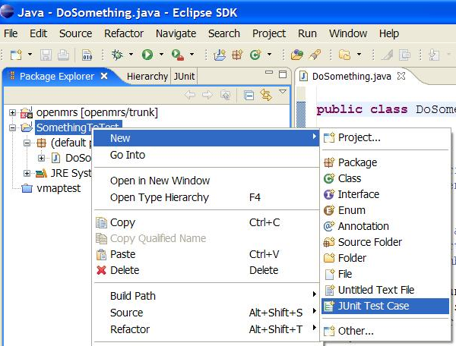
Creating a Test Case
Right-click a file and choose New → Test Case
Or click File → New → JUnit Test Case
Next → create test case
Notes:
Set the parameters:
Junit 3.x or 4.x
name of the class
etc.

Slide 45
Run a JUnit Test
Run
Run As
Junit Test

Slide 46


JUnit in other IDE
JUnit in Maven?
https://maven.apache.org/index.html
JUnit in Visual Studio? https://blogs.msdn.microsoft.com/visualstudio/2017/12/01/announcing-junit-support-for-visual-studio-code/
JUnit in Ant?
https://ant.apache.org/manual/Tasks/junitlauncher.html

Slide 47
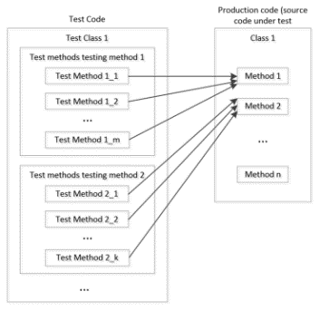
Test Case Structure

Slide 48
Test Suites
Test suite: One class that runs many JUnit tests
An easy way to run all of your app's tests at once
Actual class to be tested in your code
A test class
Notes:
TestSuites collect a selection of tests to run them as a unit

Slide 49
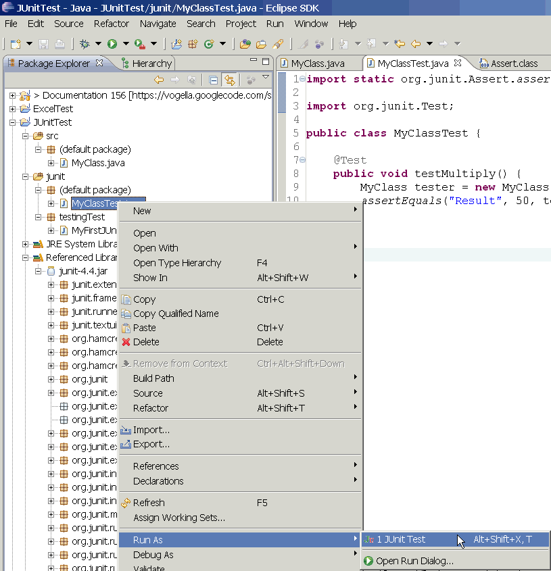
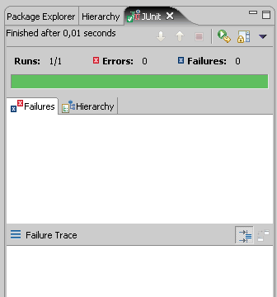
Running a Test
Right click it in the Eclipse Package Explorer at left; choose:
Run As → JUnit Test
The JUnit bar will show green if all tests pass, red if any fail
The Failure Trace shows which tests failed, if any, and why

Slide 50
Running a Test
Examine JUnit red bar

Slide 51
Viewing Results in Eclipse

Slide 52
Writing methods in Test Case
JUnit’s testing pattern:
Set up preconditions
Exercise functionality being tested
Check postconditions
← @Before method
← @Test method
← @After method

Slide 53
JUnit Test Fixtures
A test fixture is the state of the test
Objects and variables that are used by more than one test
Initializations (prefix values)
Reset values (postfix values)
Different tests can use the objects without sharing the state
Objects used in test fixtures should be declared as instance variables
They should be initialized in a @Before method
Can be deallocated or reset in an @After method
Introduction to Software Testing, Edition 2 (Ch 3) © Ammann & Offutt

Slide 54
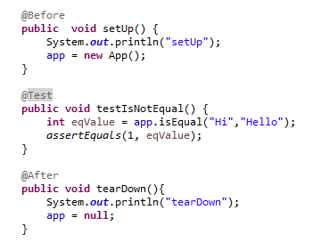
Test Case
Setup (@Before, @BeforeClass, @BeforeAll)
Exercise (@Test, calling the code from SUT)
Verify (@Test, checking the result returned from SUT)
Tear down (@After, @AfterClass, @AfterAll)
Setup
Exercise
Verify
TearDown
Notes:
The code marked @Before is executed before each test, while @BeforeClass runs once before the entire test fixture.

Slide 55
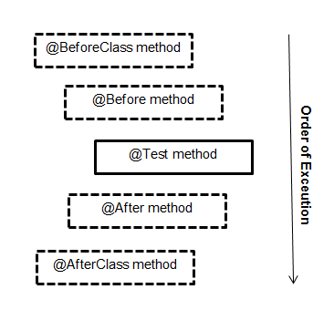
Setup and Teardown
@Before
public void name() { ... }
@After
public void name() { ... }
Methods to run before/after each test case method is called
@BeforeClass
public static void name() { ... }
@AfterClass
public static void name() { ... }
Methods to run once before/after the entire test class runs

Slide 56
Test Case - Assertions
Note: expected comes before actual
Several assertions
void assertEquals(boolean expected, boolean actual)
void assertTrue(boolean expected, boolean actual)
void assertFalse(boolean condition)
void assertNotNull(Object object)
void assertNull(Object object)
void assertSame(boolean condition)
void assertNotSame(boolean condition)
void assertArrayEquals(expectedArray, resultArray)
http://junit.sourceforge.net/javadoc/org/junit/Assert.html

Slide 57
JUnit assert*() Methods
assertTrue(”message”, condition) | fails if the boolean condition is false
assertFalse(”message”, condition) | fails if the boolean condition is true
assertEquals(expected, actual) | fails if the values are not equal
assertSame(expected, actual) | fails if the values are not the same (by ==)
assertNotSame(expected, actual) | fails if the values are the same (by ==)
assertNull(“message”, value) | fails if the given value is not null
assertNotNull(“message”, value) | fails if the given value is null
fail(“message”) | causes current test to immediately fail
Each method can also pass a string message to display/log if it fails:
e.g. assertEquals("message", expected, actual)
Complete list: http://junit.sourceforge.net/javadoc/org/junit/Assert.html

Slide 58
JUnit Assert*() Methods
For a boolean condition
assertTrue(“message for fail”, condition);
assertFalse(“message”, condition);
For object, int, long, and byte values
assertEquals(expected_value, actual_value);
For float and double values
assertEquals(expected, actual, error);
For objects references
assertNull(reference)
assertNotNull(reference)
Immediate fail
fail()
Note: use assertNull() instead of
assertSame() for objects

Slide 59
Assertion - Exercise
What's the actual use of ‘fail()’ assertion?
Mark a test that is incomplete, so it fails and warns you until you can finish it
Or force to throw an exception
Why there is no ‘pass()’ assertion?
As long as the test doesn't throw an exception, it passes, so success is the default value
Notes:
Q. Why is there no pass method?
A. As long as the test doesn't throw an exception, it passes, unless your @Test annotation specifies an expected exception. I suppose a pass() could throw a special exception that JUnit always interprets as passing, so as to short circuit the test, but that would go against the usual design of tests (i.e. assume success and only fail if an assertion fails) and, if people got the idea that it was preferable to use pass(), it would significantly slow down a large suite of passing tests (due to the overhead of exception creation). Failing tests should not be the norm, so it's not a big deal if they have that overhead.

Slide 60
Assert Method Messages
Messages helps documents the tests
Messages provide additional information when reading failure logs
Each assert method has an equivalent version that does not take a message – however, this usage is usually not recommended

Slide 61
Assert per Test Case
Tests cases should normally not contain a large number of assert statements
JUnit stops processing a test method as soon as one test fails
Including only one assert per test method leads to setting up the same test infrastructure repeatedly
Can define a common test infrastructure in setup and teardown methods in the test class

Slide 62
Test Code: Execution Order
Junit does not follow the given order of test methods in the test class, for execution
Tests should be self-contained and not care about each other
Things to avoid in tests
Constrained test order:
Test A must run before Test B
Tests call each other: Test A calls Test B's method (calling a shared helper is OK, though)

Slide 63
Test Code: Execution Order
Test execution order
Don’t assume any fixed order

Slide 64
JUnit Exercise: Black Box
Given a Date class with the following methods:
public Date(int year, int month, int day)
public Date() //today
public int getDay(), getMonth(), getYear()
public void addDays(int days) //advance by days
public int daysInMonth()
public String dayOfWeek() //e.g. Sunday
public boolean equals(Object o)
public boolean isLeapYear()
public void nextDay() //advance by 1 day
public String toString()
Come up with unit tests to check the following:
That no Date object can ever get into an invalid state
That the addDays method works properly
← Our focus
Notes:
a good equals method has some initial checks like checking for null, checking whether this == that, check instanceof, etc... then it calls compareTo

Slide 65
What's Wrong with This?
public class DateTest {
@Test
public void test1() {
Date d = new Date(2050, 2, 15);
d.addDays(4); // Advance by 4 days
assertEquals(d.getYear(), 2050);
assertEquals(d.getMonth(), 2); // February
assertEquals(d.getDay(), 19); // 19th
}
@Test
public void test2() {
Date d = new Date(2050, 2, 15);
d.addDays(14); // Test Feb for 28 days
assertEquals(d.getYear(), 2050);
assertEquals(d.getMonth(), 3); // March
assertEquals(d.getDay(), 1); // First
}
}
What about Leap year?
Notes:
Note: We are assuming getYear(), getMonth() and getDay() are working correctly!!
Our test for addDay() should not have any reference to the other methods.
So not a very good test case. How to overcome this? Mocking?

Slide 66
Well Structured Assertions
public class DateTest {
@Test
public void test1() {
Date d = new Date(2050, 2, 15);
d.addDays(4);
assertEquals(2050, d.getYear()); // NOTE: expected
assertEquals(2, d.getMonth()); // value should
assertEquals(19, d.getDay()); // be at LEFT
}
@Test
public void test2() {
Date d = new Date(2050, 2, 15);
d.addDays(14);
assertEquals("year after +14 days", 2050, d.getYear());
assertEquals("month after +14 days", 3, d.getMonth());
assertEquals("day after +14 days", 1, d.getDay());
} // test cases should usually have messages explaining
} // what is being checked, for better failure output

Slide 67
Naming Test Cases
public class DateTest {
@Test
public void test_addDays_withinSameMonth () {
Date actual = new Date(2050, 2, 15);
actual.addDays(4);
Date expected = new Date(2050, 2, 19);
assertEquals("date after +4 days", expected, actual);
}
// give test case methods really long descriptive names
@Test
public void test_addDays_wrapToNextMonth() {
Date actual = new Date(2050, 2, 15);
actual.addDays(14);
Date expected = new Date(2050, 3, 1);
assertEquals("date after +14 days", expected, actual);
}
// give descriptive names to expected/actual values
}
public class DateTest {
@Test
public void test_1 () {
Date actual = new Date(2050, 2, 15);
actual.addDays(4);
Date expected = new Date(2050, 2, 19);
assertEquals("date after +4 days", expected, actual);
}
// give test case methods really long descriptive names
@Test
public void test_2() {
Date actual = new Date(2050, 2, 15);
actual.addDays(14);
Date expected = new Date(2050, 3, 1);
assertEquals("date after +14 days", expected, actual);
}
// give descriptive names to expected/actual values
}

Slide 68
What's Wrong with This?
public class DateTest {
@Test
public void test_addDays_addJustOneDay_1() {
Date actual = new Date(2050, 2, 15);
actual.addDays(1);
Date expected = new Date(2050, 2, 16);
assertEquals(
"should have gotten " + expected + "\n" +
" but instead got " + actual\n",
expected, actual);
}
...
}
JUnit will already show the expected and actual values in its output and no need to repeat them in the assertion message

Slide 69
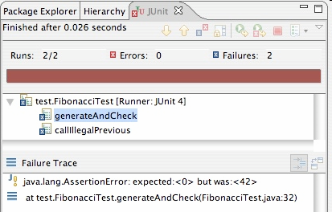
Good Assertion Messages
public class DateTest {
@Test
public void test_addDays_addJustOneDay_1() {
Date actual = new Date(2050, 2, 15);
actual.addDays(1);
Date expected = new Date(2050, 2, 16);
assertEquals("adding one day to 2050/2/15",
expected, actual);
}
...
}
// JUnit will already show
// the expected and actual
// values in its output;
//
// don't need to repeat them
// in the assertion message

Slide 70
Annotations - Pervasive Timeouts
public class DateTest {
@Test(timeout = DEFAULT_TIMEOUT)
public void test_addDays_withinSameMonth_1() {
Date d = new Date(2050, 2, 15);
d.addDays(4);
Date expected = new Date(2050, 2, 19);
assertEquals("date after +4 days", expected, d);
}
@Test(timeout = DEFAULT_TIMEOUT)
public void test_addDays_wrapToNextMonth_2() {
Date d = new Date(2050, 2, 15);
d.addDays(14);
Date expected = new Date(2050, 3, 1);
assertEquals("date after +14 days", expected, d);
}
// It is good to have a timeout for every test case
// so it can't lead to an infinite loop;
// good to set a default, too
private static final int DEFAULT_TIMEOUT = 2000;
}

Slide 71
What's Wrong with This?
public class DateTest {
// test every day of the year
@Test(timeout = 10000)
public void tortureTest() {
Date date = new Date(2050, 1, 1);
int month = 1;
int day = 1;
for (int i = 1; i < 365; i++) {
date.addDays(1);
if (day < DAYS_PER_MONTH[month]) {day++;}
else {month++; day=1;}
assertEquals(new Date(2050, month, day), date);
}
}
private static final int[] DAYS_PER_MONTH = {
0, 31, 28, 31, 30, 31, 30, 31, 31, 30, 31, 30, 31
}; // Jan Feb Mar Apr May Jun Jul Aug Sep Oct Nov Dec
}
Notes:
Avoid if … else
Note: Exhaustive test usually is a waste of time. Also guaranteed to fail!

Slide 72
Trustworthy Tests
Test one thing at a time per test method
10 small tests are much better than 1 test 10x as large
Each test method should have few (likely 1) assert statements
If you assert many things, the first that fails stops the test
You won't know whether a later assertion would have failed
Tests should avoid logic
minimize if/else, loops, switch, etc.
avoid try/catch
If it's supposed to throw, use expected= ... if not, let JUnit catch it
Torture tests are okay, but only in addition to simple tests

Slide 73
Data-Driven Tests
Problem: Testing a function multiple times with similar values
How to avoid test code bloat?
Simple example: Adding two numbers
Adding a given pair of numbers is just like adding any other pair
You really only want to write one test
Data-driven unit tests call a constructor for each collection of test values
Same tests are then run on each set of data values
Collection of data values defined by method tagged with @Parameters annotation

Slide 74
Data-Driven Test Example
import org.junit.*;
import org.junit.runner.RunWith;
import org.junit.runners.Parameterized;
import org.junit.runners.Parameterized.Parameters;
import static org.junit.Assert.*;
import java.util.*;
@RunWith (Parameterized.class)
public class DataDrivenCalcTest
{ public int a, b, sum;
public DataDrivenCalcTest (int v1, int v2, int expected)
{ this.a = v1; this.b = v2; this.sum = expected; }
@Parameters public static Collection<Object[]> parameters()
{ return Arrays.asList (new Object [][] {{1, 1, 2}, {2, 3, 5}}); }
@Test public void additionTest()
{ assertTrue ("Addition Test", sum == Calc.add (a, b)); }
}
Test 1
Test values: 1, 1
Expected: 2
Constructor is called for each triple of values
Test 2
Test values: 2, 3
Expected: 5
Test method

Slide 75
Testing for Exceptions
@Test(expected = ExceptionType.class)
public void name() {
...
}
Will pass if it does throw the given exception
If the exception is not thrown, the test fails
Use this to test for expected errors
@Test(expected = ArrayIndexOutOfBoundsException.class)
public void testBadIndex() {
ArrayIntList list = new ArrayIntList();
list.get(4); // should fail
}

Slide 76
JUnit - Parameterized Tests
In JUnit 4.x, use @RunWith annotation to define a test runner to use
Another test runner that’s bundled with the JUnit distribution is the parameterized test runner
Parameterized tests allows running the same test repetitively using different input test data
JUnit 5 supports parameterized tests by default

Slide 77
JUnit - Parameterized Tests
There are five steps to create a parameterized test
Annotate test class with @RunWith(Parameterized.class)
Create a public static method annotated with @Parameters that returns a Collection of Objects (as Array) as test data set
Create a public constructor that takes in what is equivalent to one "row" of test data
Create an instance variable for each "column" of test data
Create your test case(s) using the instance variables as the source of the test data

Slide 78
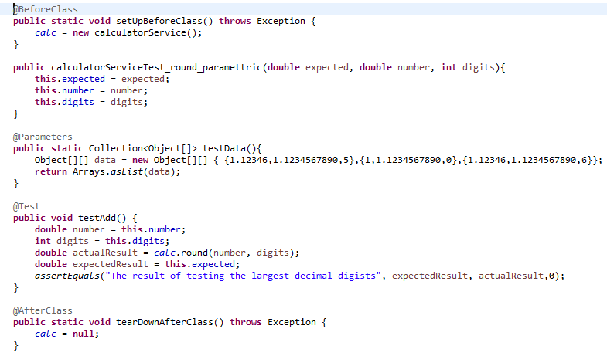
Parameterized Class
@RunWith(Parameterized.class)

Slide 79
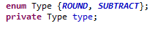
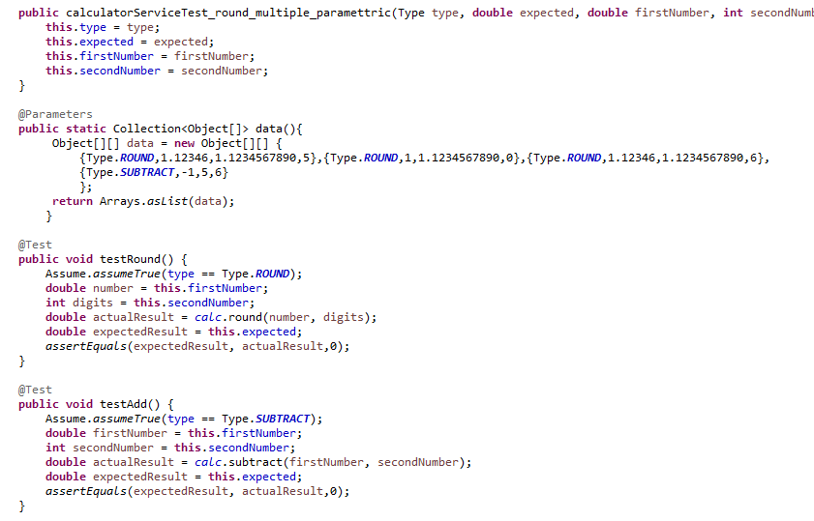
Parameterizing Multiple Tests

Slide 80

Section 4
Dependencies
Stubbing – Mocking

Slide 81
Isolating Unit Tests
SUT’s that have no collaborators should be straightforward to test
But typically units have dependencies
Remember UML’s collaboration diagram
Unit tests should NOT have dependencies, though (independent runs)
Testing collaborative units together ← feature test

Slide 82
Seams
In order to avoid accessing external units, there should be clear “seams” that separate units from each other
A seam is a place where you can substitute alternative functionality, e.g., test doubles

Slide 83
Doubles
A test double is a replacement for a DOC (Dependent On Component)
Example
A system might send an email if a particular request fails (insufficient funds, insufficient stock on hand, security violation, etc.)
Since we don’t really want to send the email, we need to provide replacement code that appears to send the email
We will typically want to verify
that the email was “sent”

Slide 84
The SUT
SUT is the portion of a system that is being tested (may be one method or class or a collection of classes or components)
Test Driver: Partial implementation of a component that depends on an SUT
If the SUT collaborates with any other classes, those classes are referred to as “depended on components” (DOC’s)

Slide 85
Test Doubles
Several of them exist
In this course we focus on stubs and mock objects
State testing
Behavioral testing
Notes:
Dummy objects are passed around but never actually used. Usually they are just used to fill parameter lists.
Fake objects actually have working implementations, but usually take some shortcut which makes them not suitable for production (an in memory database is a good example).
Stubs provide canned answers to calls made during the test, usually not responding at all to anything outside what's programmed in for the test. Stubs may also record information about calls, such as an email gateway stub that remembers the messages it 'sent', or maybe only how many messages it 'sent'.
Mocks are what we are talking about here: objects pre-programmed with expectations which form a specification of the calls they are expected to receive.

Slide 86
Stubs
A simple test double
Supplies responds to requests from the SUT
Stub will contain pre-defined responses to specific requests
e.g. getStudent(“100”) causes a Student object to be returned
The Student object may be Student 100 or the same object may returned regardless of the student number
e.g. a program that reads from a sensor feed can be tested by getting the same info from a file
A stub is often hand-coded in the implementation language

Slide 87
Test Lifecycle with Stubs
Setup - Prepare object that is being tested and its stubs collaborators
Exercise - Test the functionality
Verify state - Use asserts to check object’s state
Teardown - Clean up resources
← usually in @Before
← in @Test
← usually in @After
[Gerard Meszaros xUnit Test Patterns]

Slide 88
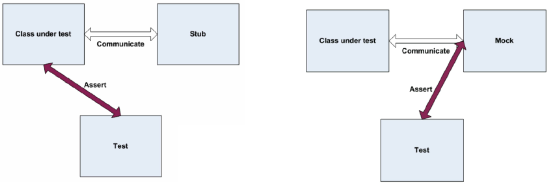
Mock Objects
A fake object that decides whether a unit test has passed or failed by watching interactions between objects
SUT
SUT

Slide 89
Mock Objects
Why do we need mock object?
When a unit of code depends upon an external object
Mock object
Dummy implementation for an interface or a class in Mock framework
Mock framework
jMock, Mockito, PowerMocks, EasyMock (Java)
SimpleTest / PHPUnit (PHP)
FlexMock / Mocha (Ruby)
etc.

Slide 90
Mock vs. Stub
State testing: “What is the result?”
Both mocks and stubs
Behavioral testing: “How the result has been achieved?”
Only mocks
Learn to write mocks. They can be used everywhere!

Slide 91
Mock vs. Stub
A stub gives out data that goes to the object/class under test
The unit test directly asserts against class under test, to make sure it gives the right result when fed this data
A mock is created and waits to be called by the class under test (A)
Maybe it has several methods expecting a call from A
It makes sure that it was contacted in exactly the right way
If A interacts with B the way it should, the test passes

Slide 92
Test Lifecycle with Mocks
Setup data - Prepare object that is being tested
Setup expectation - Prepare expectations in mock that is being used by primary object
Exercise - Test the functionality
Verify expectations - Verify that correct methods has been invoked in mock
Verify state - Use asserts to check object’s state
Teardown - Clean up resources
http://martinfowler.com/articles/mocksArentStubs.html

Slide 93
Mock - Summary

Slide 94
Mocking & Integration Testing
The definitions are not very clear
In this course when testing interactions between two objects:
Using a mock → unit testing
Using actual implementations → integration testing
We will talk about integration testing later

Slide 95
Mock Object Frameworks
Stubs are often best created by hand/IDE
Mocks are tedious to create manually
Mock object frameworks help with the process
Frameworks provide the following:
Auto-generation of mock objects that implement a given interface
Logging of what calls are performed on the mock objects
Methods/primitives for declaring and asserting your expectations

Slide 96

jMock
How to test things that involve external components with jMock?
jMock can be used together with JUnit not instead of it
Mock vs. stub
https://martinfowler.com/articles/mocksArentStubs.html

Slide 97
jMock API
Specifying objects and calls:
oneOf(mock), exactly(count).of(mock),
atLeast(count).of(mock), atMost(count).of(mock),
between(min, max).of(mock)
allowing(mock), never(mock)
The above accept a mock object and return a descriptor that you can call methods on, as a way of saying that you demand that those methods be called by the class under test
atLeast(3).of(mockB).method1();
"I expect that method1 will be called on mockB 3 times here"

Slide 98
JMock Expected Actions
will(action)
actions: returnValue(v), throwException(e)
values:
equal(value), same(value), any(type),
aNull(type), aNonNull(type), not(value),
anyOf(value1, ..,valueN)
– oneOf(mockB).method1();
will(returnValue(anyOf(1, 4, -3)));
"I expect that method1 will be called on mockB once here, and that it will return either 1, 4, or -3."

Slide 99
jMock How to Use it?
With the help of jMock we can test a class independently when it depends on another class by creating a mock of dependent class
What we need?
Eclipse and Junit and jMock jars included in the classpath
Notes:
Perhaps all three below: jmock Junit4, hamcrest-core-1.3.jar, hamcrest-library-1.3.jar

Slide 100
jMock How to Use it?
Let’s create an interface named ITestInterface and put the following code in it:
package test;
public interface ITestInterface
{
public int test();
}
http://www.askeygeek.com/jmock-for-beginners/

Slide 101
jMock How to Use it?
Create TestClass1. Put the following code in this class
This is the class that SUT depends on
package test;
public class TestClass1 implements ITestInterface
{
public int test()
{
return 3;
}
}

Slide 102
jMock How to Use it?
Create TestClass2. Put the following code in this class
This is our SUT
package test;
public class TestClass2
{
ITestInterface testInterface;
public TestClass2()
{
this.testInterface=testInterface;
}
public int testMock()
{
int result=testInterface.test(); //Dependency here
return result;
}
}
Notes:
The testMock() method cannot run independent of the TestClass1.
How to remove this dependency when testing TestClass2?

Slide 103
jMock How to Use it?
Create TestClass3. Put the following code in this class
This is our JUnit testing code
package test;
import junit.framework.Assert;
import org.jmock.Mockery;
import org.junit.Test;
public class TestClass3 //Junit Test
{
@Test
public void testJmock()
{
org.jmock.Mockery TestInterfaceMock= new Mockery();
final ITestInterface testInterface=TestInterfaceMock.mock(ITestInterface.class);
TestInterfaceMock.checking(new org.jmock.Expectations()
{{
oneOf(testInterface).test();
will(returnValue((3))); // will return by mock object
}});
int j=testInterface.test();
System.out.println(j);
Assert.assertEquals(j, 3); //Pass if returns 3
}
}
Mock object
A mock object has the same method as the called object but not the implementation of it. It returns the expected outcome only.

Slide 104
jMock How to Use it?
TestClass1 implements the interface ITestInterface
Here TestClass2 is dependent on TestClass1
In unit testing we are not doing new of TestClass1 in TestClass2 We use mock object in unit testing it
In TestClass3 we are making the Mock object of ITestInterface We are setting the expectation for this object to return 3 when it is called during the unit testing of TestClass2
For example in TestClass3 when we make a call to testInterface.test() the call goes to TestClass2. In TestClass2 when we call testInterface.test() the value is returned by the mock object. In this way we are testing TestClass2 independent of TestClass1.

Slide 105
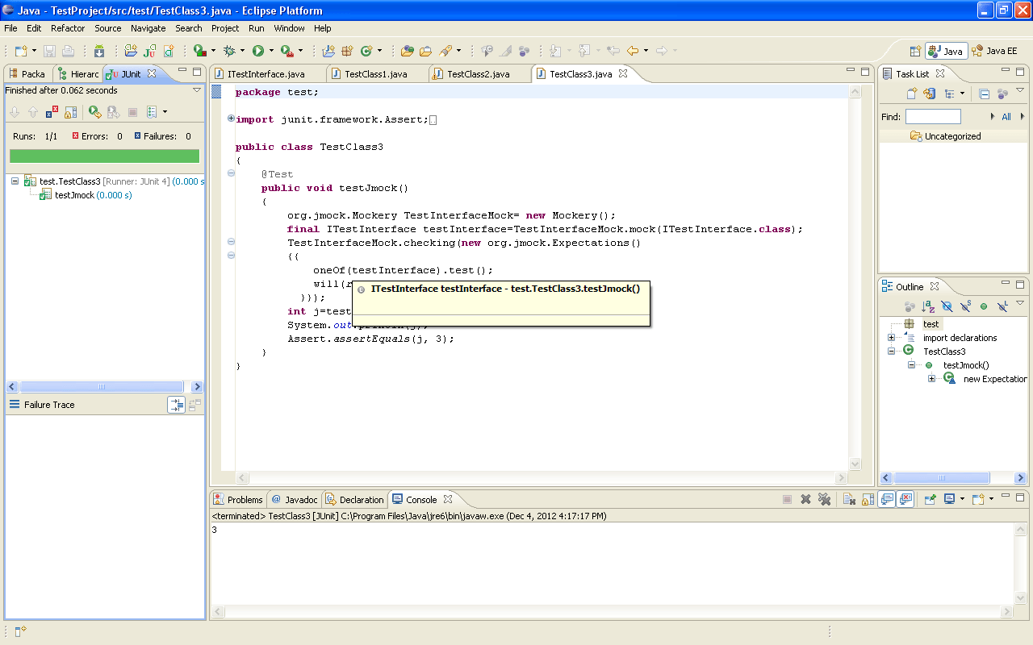
jMock How to Use it?
Right click on TestClass3 and select run as Junit test and check test executed successfully

Slide 106
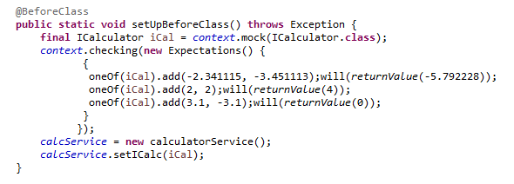
Mock - Sample
JMock
Jmock: https://github.com/jmock-developers

Slide 107
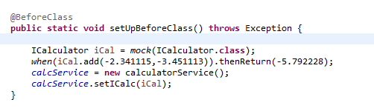
Mock - Sample
Mockito
http://site.mockito.org/

Slide 108
JMock Example 2
A test for a publish/subscribe message system
A Publisher sends messages to zero or more Subscribers
We want to test the Publisher, which involves testing its interactions with its Subscribers

Slide 109
JMock Example 2

Slide 110
JUnit Summary
Tests need failure atomicity (ability to know exactly what failed)
Each test should have a clear, long, descriptive name
Assertions should always have clear messages to know what failed
Write many small tests, not one big test
Each test should have roughly just 1 assertion at its end
Test for expected errors / exceptions
Choose a descriptive assert method, not always assertTrue
Choose representative test cases from equivalent input classes
Avoid complex logic in test methods if possible
Use helpers, @Before to reduce redundancy between tests
Next week

